Slide 1


Profit, Loss & Discount Session No.: Course Name: Course Code: O1UA422L Instructor Name: Duration: 50 Mins Date of Conduction of Class:

Slide 2

Learning Outcome:
Learning Outcome 1: Define cost price, selling price, profit, and loss.
Learning Outcome 2: Solve real-life like application problems involving profit and loss.

Slide 3
Profit and Loss
Profit or Gain = Selling price – Cost Price
• Loss = Cost Price – Selling Price
• Profit % = (Profit /Cost Price) x 100
• Loss % = (Loss / Cost price) x 100
• Discount = Marked Price – Selling Price
• Discount % = (Discount/Marked price) x 100

Slide 4
Profit and Loss
CP = Cost Price = The price at which an object is Purchased
SP = Selling Price = The price at which the object is Sold.
When, SP < CP → Loss = CP – SP
When, SP > CP → Profit = SP – CP
Note: Loss% and Profit% both are calculated upon CP

Slide 5
Profit and Loss
When profit% is given, say, 10% profit
If 10% profit, then we simply do:
CP = 100% and SP = 110%
When loss% is given, say, 10% loss
For 10% loss, then we simply do: CP = 100% and SP = 90%

Slide 6
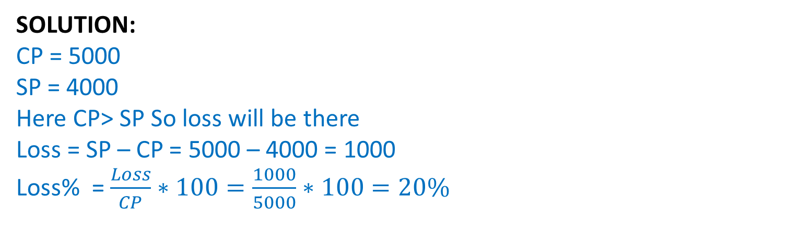
Profit and Loss
Problem: A TV is purchased at Rs. 5000 and sold at Rs. 4000, find the lost percent.

Slide 7
Profit and Loss
Question 1: CP = Rs.5000
P = 20 %
SP = ?
Question 2: CP = Rs.800
L = 30 %
SP = ?
Notes:
Solution 1 :
SP = 120% of 5000 = 120/100*5000 = 6000
Solution 2 :
SP = 70% of 800 = 70/100*800 = 560

Slide 8
Profit and Loss
Question 3: SP = Rs.720
P = 20 %
CP = ?
Question 4: SP = Rs. 810
L = 10 %
CP = ?
Notes:
Solution 1 :
SP = 120% of CP = 720
CP = 720/120*100 = 600
Solution 2:
SP = 90% of CP = 810
CP = 810/90 *100 =900

Slide 9
Profit and Loss
Question 5: A shopkeeper expects a gain of 22.5% on his cost price. If in a week, his sale was of Rs. 1568, what was his profit?
A] 288
B] 144
C] 236
D] 280
Notes:
Option : A
Let CP = 100
Gain = 22.5%
So, SP = 100+22.5= 122.5
122.5=784
1 = 1568/122.5 = 12.8
Gain = 22.5 = 12.8 x22.5 = 288

Slide 10
Profit and Loss
Question 6: When a plot is sold for Rs. 15,300, the owner loses 15%. At what price must that plot be sold in order to gain 20%?
A] 26000
B] 21600
C] 26200
D] 26800
Notes:
Option: B
Let CP = 100
Loss = 15% = 15
Original SP = 100 – 15 = 85
New SP at 20% profit = 100+20 = 120
85 = 15300
1 = 15300/85 = 180
New SP = 120 = 120*180 = 21600

Slide 11
Profit and Loss
Question 7: In a certain store, the profit is 350% of the cost. If the cost increases by 25% but the selling price remains constant, approximately what percentage of the selling price is the profit?
A] 70.2
B] 75
C] 72.2
D] 75.5
Notes:
Option: C
Let Initial CP = 100
Profit % = 350%
Profit = 350
SP = 100+350 = 450
New CP = 100+ 25= 125
New SP = 450
New profit = 450 – 125 = 325
% = 325/450 * 100 = 72.2

Slide 12
Profit and Loss
Question 8: A shopkeeper sells his goods at 20% profit. Had he purchase it 10% less and sold it for Rs.18 less then he would get 30% profit. Find the initial CP of that article.
[A] 540
[B] 600
[C] 1200
[D] 720
Notes:
Option: B
Let Initial CP = 100
Initial Profit% = 20%
Initial SP = 100+20 = 120
New CP = 100 – 10 = 90
New Profit%= 30%
New profit = 30% of 90 = 27
New SP = 90+27 = 117
Difference between Initial SP – New SP = 120 – 117 = 3
= 18
1 = 18/3 = 6
So, initial CP = 6 = 6*100 = 600

Slide 13
Profit and Loss
Question 9: A shopkeeper sold an article at 25% profit. If the CP and SP are decreased by Rs.20 and Rs.40 respectively then the profit percent would be decreased by 25 %. Find the CP of the article.
[A] 320
[B] 200
[C] 180
[D] 240
Notes:
Option A
Let Initial CP = 100K
SP = 125K
Initial Profit = 125K – 100K = 25K
New CP = 100K – 20
New SP = 125K – 40
New Profit = (125K – 40) – (100K – 20) = 25K – 20
Profit decrease by 25%
25K x (100- 25)% = 25K – 20
25K x 3/4 = 25K – 20
25K = 80
K = 80/25 = 16/5
100K =320

Slide 14
Common Selling Price or Common Cost Price

Slide 15
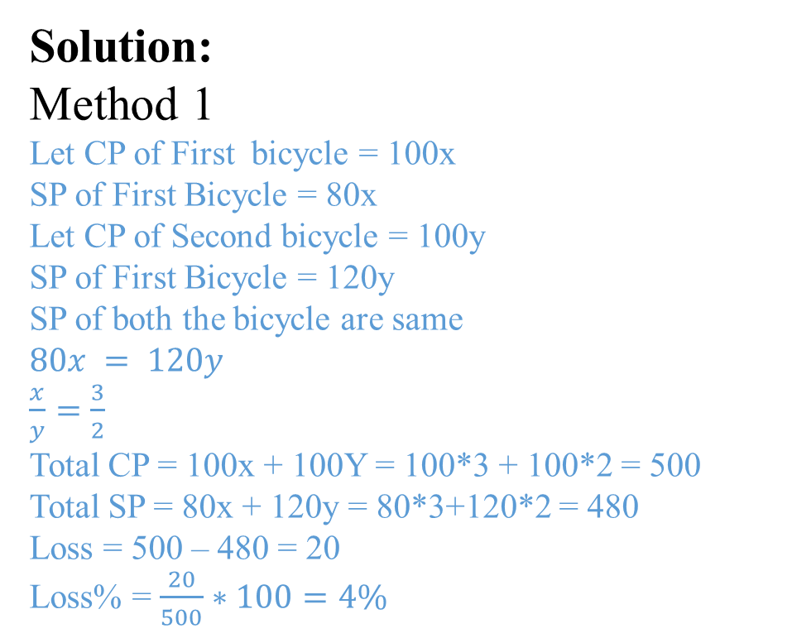
Profit and Loss
Problem: A man sold 2 bicycles at the same selling price. One at 20% loss and other at 20% profit. Find overall profit and loss percentage.
If the selling price of two articles is same and the profit% & loss% (say y%) is also common, then there will definitely be a loss of y^2/100 %
Therefore, loss% = 20^2/100
= 4%

Slide 16
Profit and Loss
Question 10: A shopkeeper purchase 2 articles for Rs.9600. He sold the first article at 20% loss and second article at 60% profit then he find that both the articles being sold on the same price. Find the CP of first article.
[A] 6400
[B] 3200
[C] 6000
[D] 5400
Notes:
Option: A
Let CP of First article = 100x
SP of First article = 80x
Let CP of Second article = 100y
SP of second article = 160y
SP of both the article are same
So, 80𝑥=160𝑦
𝑥/𝑦=2/1
Ratio of CP of both the article = 100x : 100y = 100*2 : 100*1 = 2: 1
2 +1 = 3 = 9600
1 = 9600/3 = 3200
So CP of first article = 2 = 2*3200 = 6400

Slide 17
Profit and Loss
Question 11: A shopkeeper sells 2 articles. He sold the first article at 15% loss and second article at 19% profit. During the whole transaction he earn a loss of Rs90. Find the CP of second article if the SP of both articles are same.
[A] 5000
[B] 4500
[C] 2000
[D] None
Notes:
Option: B
Let CP of First article = 100x
SP of First article = 85x
Let CP of Second article = 100y
SP of second article = 119y
SP of both the article are same
So, 85𝑥=119𝑦
𝑥/𝑦=119/85=7/5
Loss on first article = - 15x = - 15*7 = -105
Profit on Second article = 19y = 19*5 = 95
Overall loss in whole transection = -105+95 = -10
-10 = -90
1 = 9
Y = 9*5 = 45
CP of second article = 45*100=4500

Slide 18
Profit/Loss Percentage

Slide 19
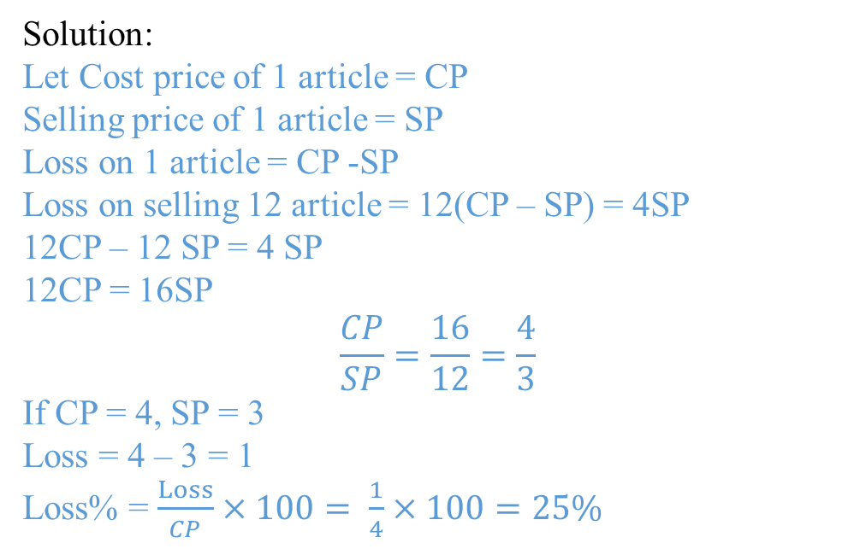
Profit and Loss
Problem: By selling 12 articles a man earn a loss of which is equal to selling price of 4 articles. Find his loss percent.
Notes:
Let Cost price of 1 article = CP
Selling price of 1 article = SP
Loss on selling 12 article = 12(CP – SP) = 4SP
12CP – 12 SP = 4 SP
12CP = 16SP
𝐶𝑃/𝑆𝑃=16/12=4/3
If CP = 4, SP = 3
Loss = 4 – 3 = 1
Loss% = 1/4×100=25%

Slide 20
Profit and Loss
Question 12: If CP of 25 articles is equal to SP of 20 articles. Find the profit or loss percent.
[A] 25% loss
[B] 25% profit
[C] 20 % profit
[D] 20 % loss
Notes:
Option B
Let Cost price of 1 article = CP
Selling price of 1 article = SP
25 ×𝐶𝑃=20×𝑆𝑃
𝐶𝑃/𝑆𝑃=20/25=4/5
If CP = 4, SP = 5
Profit = 5 – 4 = 1
Profit% = Profit/𝐶𝑃×100= 1/4×100=25%

Slide 21
Profit and Loss
Question 13: By selling 40 articles a man earn a profit of equal to cost price of 5 articles. Find his profit percent.
[A] 33.33 % profit
[B] 12.5 % loss
[C] 25 % loss
[D] 12.5 % profit
Notes:
Option: D
Let Cost price of 1 article = CP
Selling price of 1 article = SP
Profit on 1 article = SP -CP
Profit on selling 40 article = 40(SP – CP) = 5CP
40SP – 40 CP = 5CP
40SP = 40CP+5CP
40SP = 45CP
𝐶𝑃/𝑆𝑃=40/45=8/9
If CP = 8, SP = 9
Profit = 9 – 8 = 1
Profit% = Profit/𝐶𝑃×100= 1/8×100=12.5%

Slide 22
Number of Articles

Slide 23
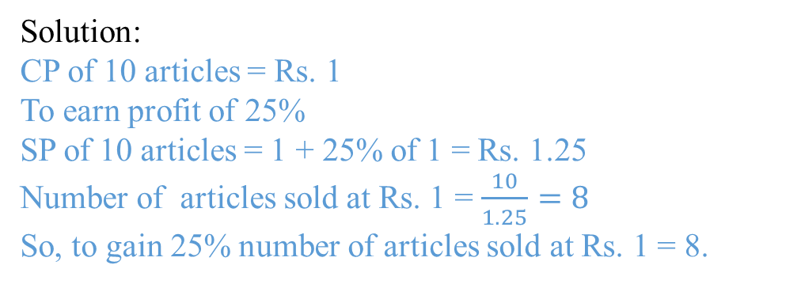
Profit and Loss
Problem: A man purchase some number of articles at the rate of 10 articles for Re.1. How many articles should he sell for Re.1 to gain 25% profit.

Slide 24
Profit and Loss
Question 14: A man purchase 50 articles for Rs.1. How many articles should he sell for Rs.1 to gain 25% profit.
[A] 21
[B] 28
[C] 40
[D] None
Notes:
Option: C
CP of 50 articles = Rs. 1
To earn profit of 25%
SP of 50 articles = 1 + 25% of 1 = Rs. 1.25
Number of articles sold at Rs. 1 = 50/1.25=40
So, to gain 25% number of articles sold at Rs. 1 = 40.

Slide 25
Profit and Loss
Question 15: A shopkeeper buy some lemons at rate of 20 for Rs.10. Again he bought the same number of lemons at rate of 10 for Rs.20. He mixed both the types and sold at 5 for Rs.10. find profit/loss %.
[A] 20 % loss
[B] 25 % loss
[C] 100 % profit
[D] None
Notes:
Option: D
CP of First type of 20 Lemons = Rs. 10
CP of Second type of 10 lemons = Rs. 20
CP of Second type of 20 Lemons = Rs. 40
Total CP of 20 lemons of first type and 20 lemons of Second type = 10 +40 = Rs. 50
Total CP of 40 lemons = Rs. 50
SP of 5 lemons = Rs. 10
SP of 40 Lemons = Rs. 80
Profit = 80- 50 = Rs. 30
Profit% = 30/50∗100=60%

Slide 26
Profit and Loss
Faulty Weights

Slide 27
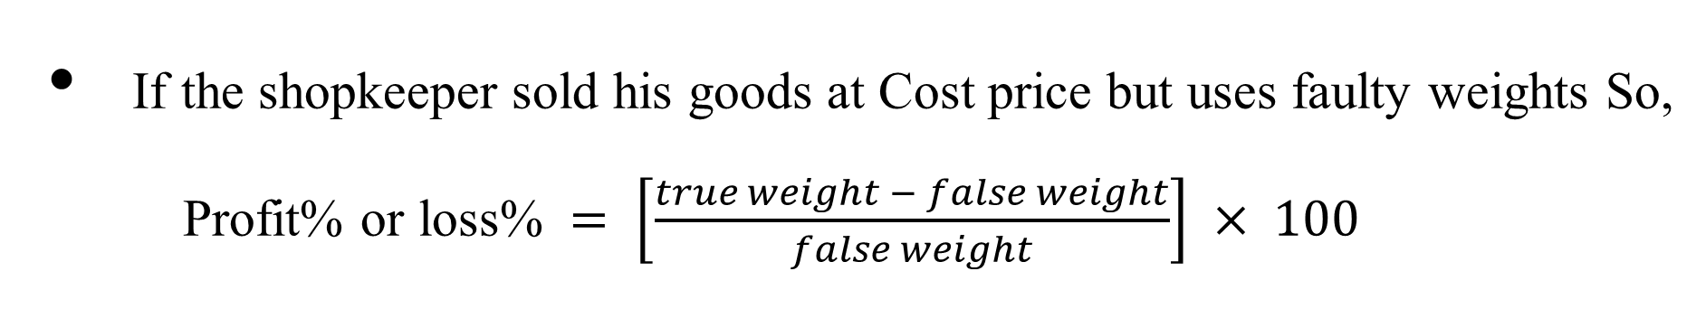
Profit and Loss

Slide 28
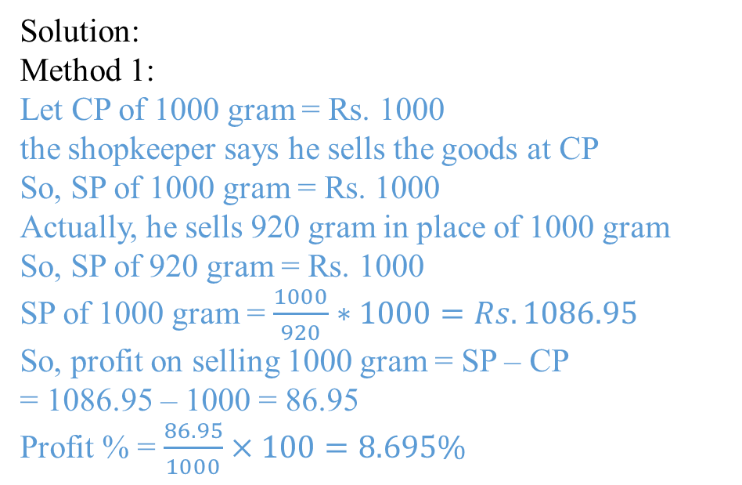
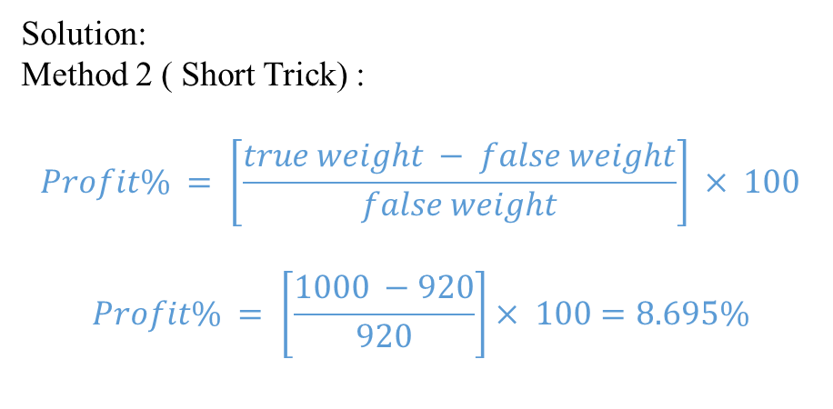
Profit and Loss
Problem: A shopkeeper professes to sell his goods at its CP, But he uses 920 gm in place of 1 kg. Find his profit percent.

Slide 29
Profit and Loss
Question 16: A shopkeeper professes to sell his goods at 20% loss, But he uses 30% less weight. Find his profit or loss percent.
[A] 14.28% profit
[B] 25% profit
[C] 25% loss
[D] None
Notes:
Option: A

Slide 30
Profit and Loss
Question 17: A trader sells pulses at a 32% profit and uses weights 20% less than the actual measure. Find his gain percentage.
[A] 72 %
[B] 62 %
[C] 58%
[D] 65%
Notes:
Option: D

Slide 31
Discount
Problems on Discount

Slide 32
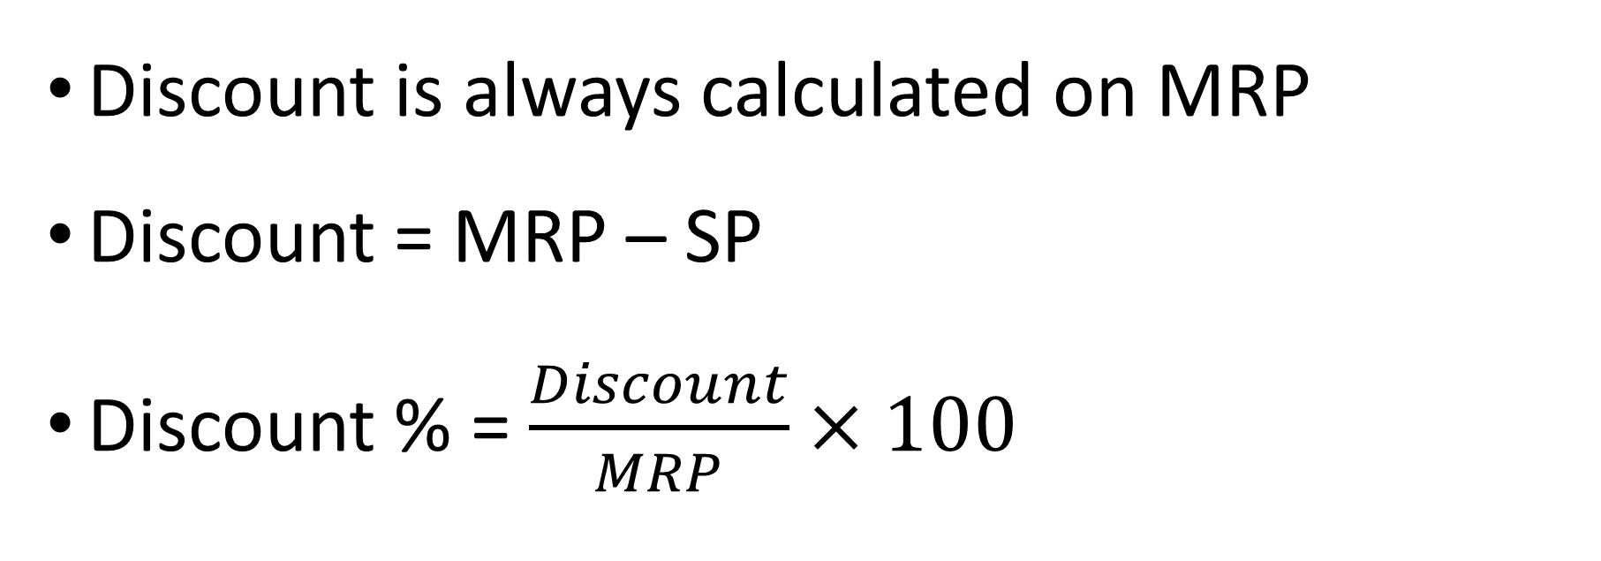
Discount

Slide 33
MP= Rs. 600
Discount =Rs.100
Mark up= Rs. 200
SP= Rs.500
Profit
= Rs.100
CP= Rs.400
A shopkeeper buys a T-shirt from wholesale market at Rs.400 and marked that article Rs.200 above the CP. After giving a discount of Rs.100 he sold it at Rs.500.

Slide 34
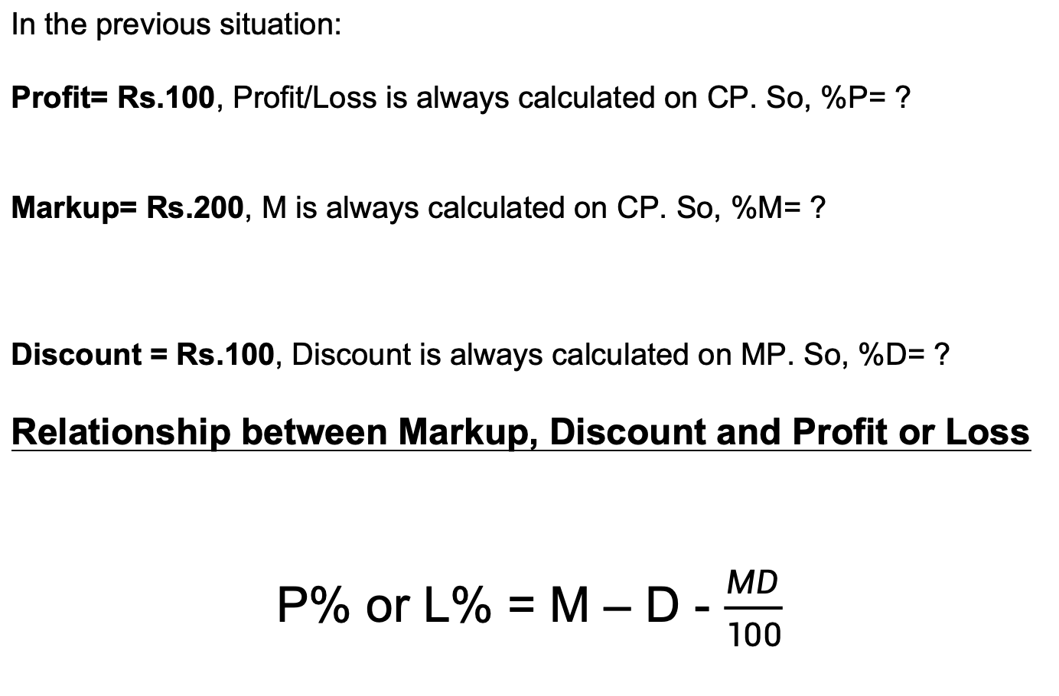
Discount

Slide 35
Discount
Question 18: A bag marked at Rs200 is sold for Rs118. The rate of discount is:
[A] 33.33%
[B] 12.5%
[C] 41%
[D] None
Notes:
Option: C
Discount = MRP – SP = 200 – 118 = 82
Discount % = 82/200×100=41%

Slide 36
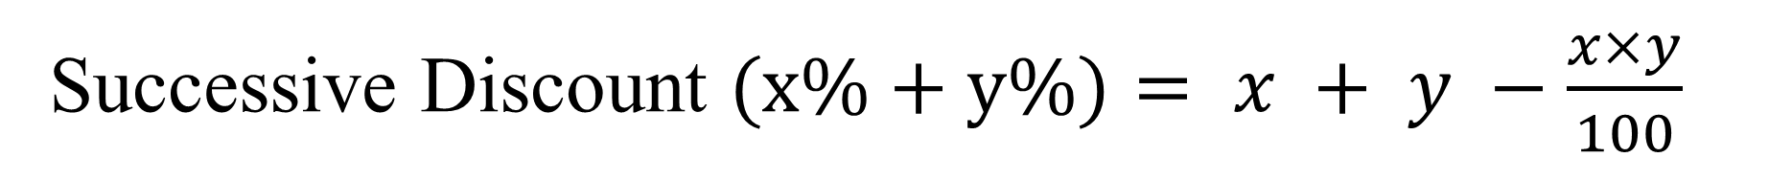
Discount

Slide 37
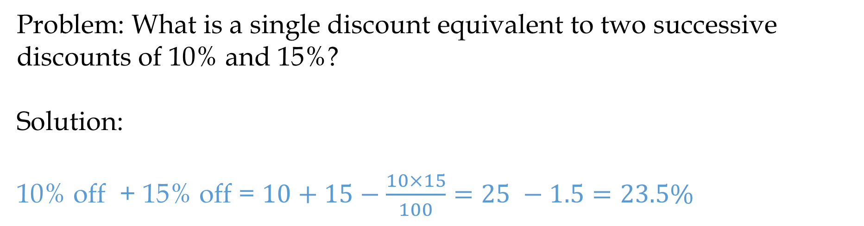
Discount

Slide 38
Discount
Question 19: An item was sold at a price after giving two successive discount of 20% and 50 %. If the selling price of the item was Rs 200, then what was the marked price of the item?
[A] 500
[B] 1280
[C] 1140
[D] None
Notes:
Option: A
Discount% = 20% off + 50 % off = 20+50−(20×50)/100=70 −10=60%
Let MRP of the item = 100
Discount % = 60%
Discount = 60
SP = MRP – Discount = 100- 60 = 40
40 = 200
1 = 200/40 = 5
MRP = 100 = 5*100 = 500

Slide 39
Discount
Question 20: The cost price of a table is Rs 700. It is sold for a profit of Rs 20 after giving 10% discount find its marked price [A] 300
[B] 600
[C] 800
[D] None
Notes:
Option: C
SP = CP + Profit = 700+20 = 720
Let MRP = 100
Discount = 10%
Discount = 10
SP =MRP – Discount = 100 – 10 = 90
90 = 720
1 = 720/90 = 8
MRP = 100 = 100*8 = 800

Slide 40
Discount
Question 21: A dishonest shopkeeper sells sugar at Rs 25/kg which he has bought at Rs 20/kg and he gives 800gm instead of 1kg. Find his actual profit percentage.
A] 50
B] 25
C] 25.5
D] 56.25
Notes:
Let CP of 1000 gram = Rs. 20
SP of 1000 gram = Rs. 25
But using false weight he gives only 800 gram in place of 1000 gram in Rs. 25
So, SP of 800 gram =Rs. 25
SP of 1000 gram =25/800×1000=𝑅𝑠. 31.25
Profit = 31.25 – 20 = 11.25
Profit% =11.25/20×100=56.25

Slide 41
Ensure attainment of LOs in alignment to the learning activities: outcomes (1-2)
Outcome 1: Students are able to calculate profit percentage and loss percentage.
Outcome 2: Students can apply profit and loss formulas in real-world business problems.

Slide 42
Information about the next lesson

Slide 43
Review and Reflection from students

